Slide 1



Macro-Hard
Team 1
Rameez Anwar
Andrea Bialkowski
Eryk Cygielski
Nermin Dedovic
Randy Ly
Jiten Patel
Dimitri Vityk

Slide 2
Front End
Login Page
D2L login (reference)
Create account optional
User Home
(After user login)
Workspace section
Projects / Groups / Tasks
Navigation Bar Placement
(top / left / right / bottom)
User profile button
(access to user profile/information)

Slide 3
Mock-ups (Simple = Good)
Login Page Layout
Main board / workspace appearance for every user
Project / groups in project / tasks within group
Prompt layout when adding a new project
Prompt layout after adding a new task
Task name / members / add members / description / objectives in description / etc.
Navigation Bar
Navigating to profile/messages/etc.
Various tools possibly
Prompt for peer evaluation after submission (1-5 rating)
1 = No contribution at all
5 = Being max contribution
User profile
Refer to the database
Functionality

Slide 4
APP Name
Manage Easy
MacroHard
Simplified
Projectify

Slide 5
P2P Evaluation (Peer-to-Peer)
Award Stars
Post Comments
Data analysis
Awards / Recognition:
Badges:
Pix
Unicode(emoji)

Slide 6
Data Analysis
Top 3
Who is doing more work?
Who is turning in the most?
Who is completing faster?
For every project
Workflow
How much work was done week 1 versus week 2?
Completion
How much has been completed?
How much still needs to be done?
Users will be judged on
their quality of work
It will show on their profiles

Slide 7
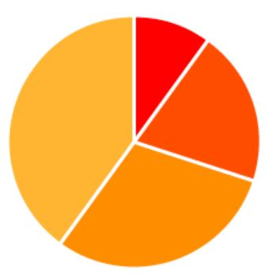
Data Analysis, cont..
For every project
&
For every group within the project
Tasks completed &
tasks yet to be complete
Tasks submitted on time & tasks submitted late
Tasks not completed &
tasks overdue
Groups get an overall view of task avg scores
Groups are putting out the best work
Groups that need help
Pie Charts

Slide 8
Peer evaluation DA
For every task after the task is done everyone involved with the task will be prompted to give a peer evaluation to every individual involved in the project.
Rating will be from 1-5 based on the level of contribution and on the quality of the work.
Every user will be able to see the average rating they got for each task.
For whoever oversees the project they’ll have a table in their data page that’ll have the name of every user in the project.
Every row in the project will have the ID, name, group, task, and the average peer score they received.
Every individual user will also see this table but only for their own tasks.

Slide 9
USER - Student/Worker
User CAN View
What can't they view?
Functionality
Communicate with other students/faculty.
Submit / work on deliverables.
Evaluate peers - comments/awards: Only within their groups or no restrictions?
Can use any features to set goals and measure their effective delivery.
Can edit/delete their profile.
Can opt into responsibilities / agreements.
Groups / tasks / comments / awards.
Everything within the project they have been assigned to.

Slide 10




USER - Faculty
Can assign student users to project teams
Communicate with students
View all schedules comments & awards
Make comments & give awards
Can attach & appoint grades
Can create projects
Can edit/delete their profile

Slide 11
USER - Administrator
Login
Manage
Maintain site
Access Databases
Activate
Deactivate
Create
Delete accounts
Analyze Usage
Analytic Tools

Slide 12
ALL USERS
Opt into responsibilities
Login Password
&
Authentication
Restricted view based on privileges

Slide 13
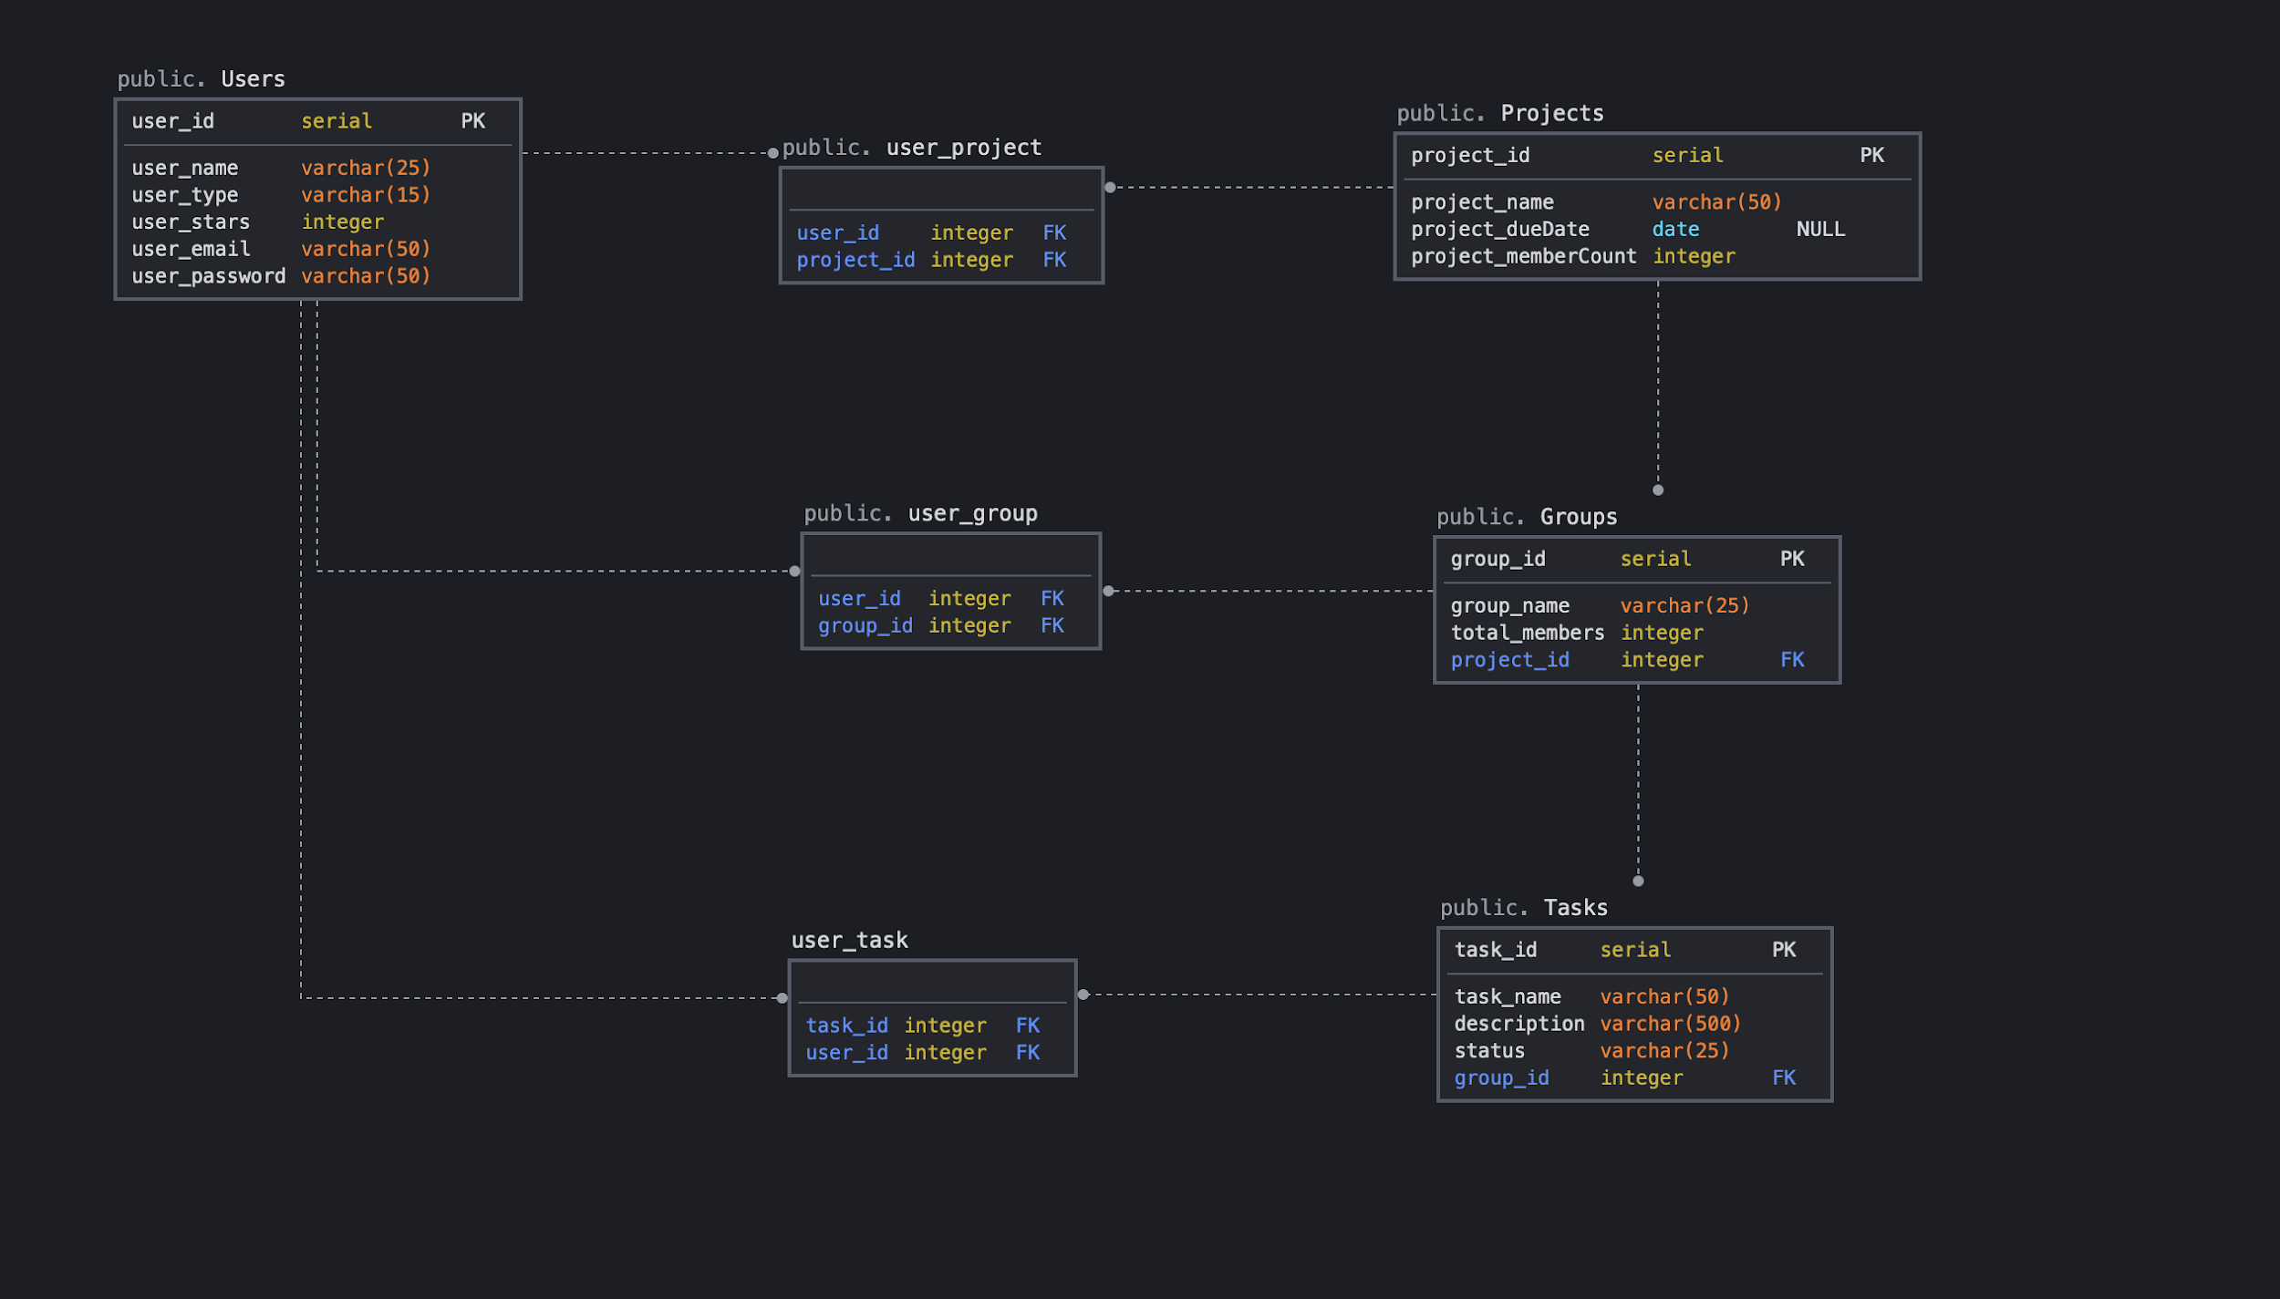
DB Diagram
Notes:
Nerm:
Upon further research on efficient DB design, I believe it would be a mistake to use Arrays as a DB datatype.
Formula for eliminating/simplifying a many-to-many relationship : create a new table and connect 2 one-to-many relationships
To clarify the M-T-M relationships :
A user can have many projects and a project can have many users, hence the user_project table
A user can be involved in many groups and a group can involve many users, hence the user_group table
A user can be involved in many tasks and a task can involve many people, hence the user_task table.
Right side explanation (One-to-many relationships) :
One project can have 1-many groups.
One group can have 1-many tasks

Slide 14
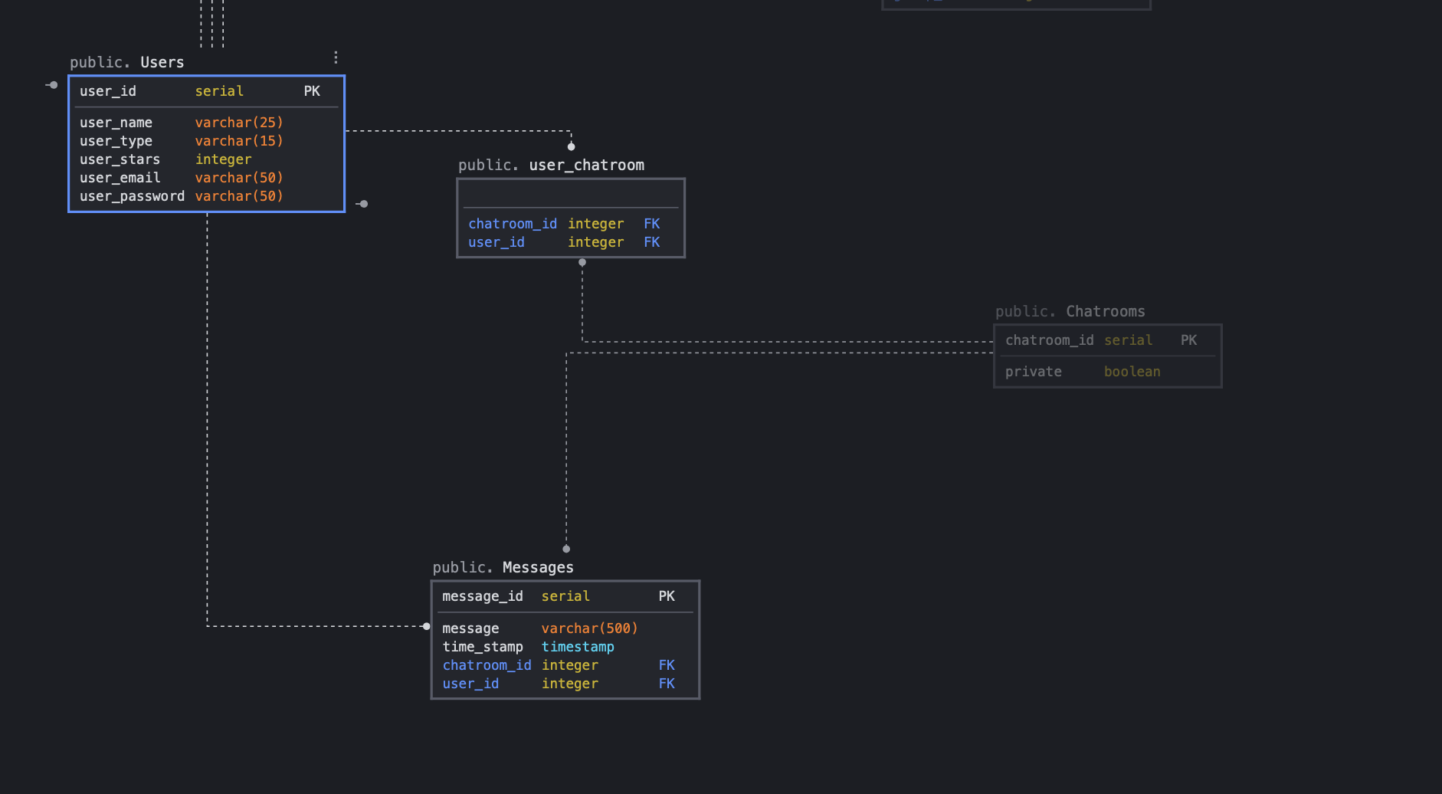
DB Chatroom
Notes:
Nerm : my interpretation (correct me if im wrong)
A user can be in many chatrooms
A chatroom can have many users (min 2 users)
A user can have many messages but a message cannot have more than one user
A chatroom can have many messages in it but a message can only be placed in one chatroom
With this DB implementation, creating and recreating chatrooms wouldnt be a problem.
When reconstructing a chatroom, we search all messages with a certain chatroom id and sort/insert all messages into the chat. Shouldnt be too big of a problem considering every DB has an efficient way of sorting dates/timestamps

Slide 15
Databases|Attribute : Data Type
Users (
user_id : serial PK
user_name : varchar(25)
user_type : integer
user_email : varchar(50)
user_password : varchar(50)
)
Projects (
project_id : serial PK
project_name : varchar(50)
project_dueDate : Date
project_memberCount : integer
)
Groups (
group_id : serial PK
group_name : varchar(25)
total_members : integer
project_id : integer FK
)
Messages (
message_id : serial PK
message : varchar(500)
time_stamp : timestamp
chatroom_id : integer FK
user_id : integer FK
)
Chatrooms (
chartoom_id : serial PK
private : boolean
)
Tasks (
task_id : serial PK
task_name : varchar(50)
Description : varchar(500)
Status : varchar(25)
group_id : integer FK
)
Notes:
Serial : automatic integer increments starting from one
varchar(n) : character varying with a limit of n
Timestamp : date and date
PK : primary key
FK : foreign key

Slide 16
Databases|Attribute : Data Type Bridges B/W M-T-M
user_project (
user_id : integer FK
project_id : integer FK
)
user_group (
user_id : integer FK
group_id : integer FK
)
user_task (
user_id : integer FK
task_id : integer FK
)
user_chatroom(
user_id : integer FK
chatroom_id : integer FK
)

Slide 17
Team Project Roles
Nerm:
Project Manager
Dimitri:
Front End
Andrea:
Front End
Randy:
Data Analysis
Jiten:
Data Analysis
Rameez:
Back End
Eryk:
Back End

